Slide 1

Analysis of Weather Dataset
Discover the hidden insights in meteorological data and unveil the secrets that weather patterns hold. Join me in an exploration of weather data analysis!
By Anshul Sharma

Slide 2
Introduction
About the Dataset
Goals of Analysis
The main focus of our project was to
perform analysis for testing the
Influences of Global Warming and finally
put forth a conclusion.
Our weather dataset comes from Kaggle.com .
URL-https://www.kaggle.com/datasets/muthuj7/weather-dataset

Slide 3
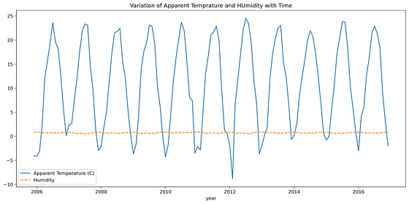

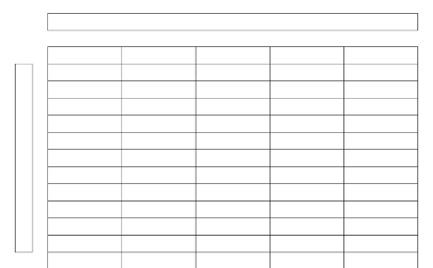
Dataset Overview
Source of the Weather Data
Number of Records and Time Span
Our weather data comes from the Kaggle.com.
The dataset covers a time span of 10 years, from 2006 to 2016, and includes over 90000 rows x 12 columns with weather observations from across the Finland.
Features or Variables
The dataset includes various features, such as temperature, humidity, wind speed, visibility etc. We have 12 rows to analyze.

Slide 4
Data Preprocessing
1
The Importance of Data Preprocessing
2
Steps Taken for Data Preprocessing
Clean and well-formatted data is essential to enable accurate analysis. In our analysis, we took great care to handle missing values, clean up data inconsistencies, and ensure the dataset was in the correct format.
We started by finding the information of data then we find the descriptive statistical details. We also checked for distinct element in data frame and remove unnecessary column. Finally, we normalized and standardized data for more accurate analysis.

Slide 5
Exploratory Data Analysis (EDA)
1
What is EDA?
EDA is a process of analyzing data to understand its characteristics and uncover patterns or relationships in the data. It can help us identify potential trends and insights.
Why Do EDA?
2
EDA is a crucial step before building a model or hypothesis testing. It allows us to get a deep understanding of the data and form hypotheses to test later.

Slide 6
Data Visualization
The Role of Data Visualization
Types of Plots for Weather Data
Data visualization is an important tool for EDA. It helps us understand data relationships and recognize patterns that might be hidden in the raw data. By using visual representation of the data, we can identify trends quickly and draw insights from them.
We used a variety of plots for weather data visualization, including line plots to check variation between Humidity and Apparent Temperature, reg plots to study relationships between variables, and heatmaps to study patterns.

Slide 7
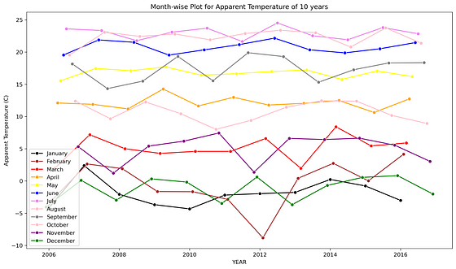
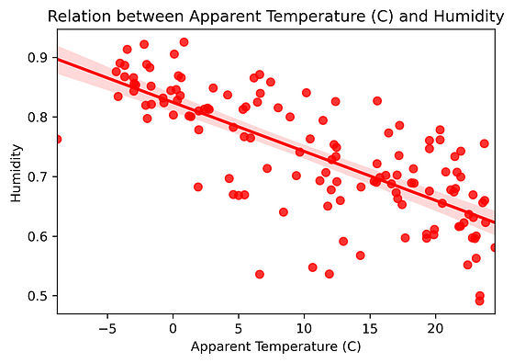
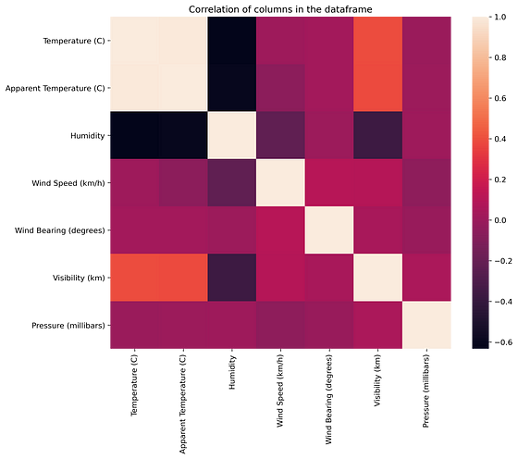
Weather Visualizations
Temperature Over Time
Temperature and Humidity
Examining temperature patterns across the time span of every month of the dataset reveals a strong fluctuation between summer and winter, as well as a gradual upward trend in temperature over the years.
A scatter plot of temperature and humidity shows a negative correlation between the two variables. As temperature goes up, humidity generally decreases.
Variation of Temperature and Humidity with time
Correlation of columns in the dataframe
The above graph displays average temperature and humidity for all 12 months over 10 years. Also tells that humidity remain constant but temperature change on regular intervals with constant amplitude.
From the Pairwise correlation chart , we can see that temperature and humidity have a high degree of correlation with each other.

Slide 8
Correlation Analysis
What is Correlation?
Correlation is a measure of the relationship between two variables. It indicates how much one variable changes with respect to another variable. A strong correlation between two variables means that they are highly related to each other.

Slide 9

Temperature Trends
1
Trends in Temperature Patterns
The Apparent Temperature has a tremendous fluctuation over this time period.There is sharp rise of temperature between year 2008-09 which again decreases in year 2009-10.
2
Anomalies in the Data
We found some anomalies in temperature patterns, such as in July August there is more temperature then overall so it a inconsistency.

Slide 10
Seasonal Patterns
Spring
Fall
In spring, temperatures gradually increase and flowers start to bloom. However, this season often means an increase in rain and thunderstorms in some areas.
Fall is characterized by cooler weather and changing colors of leaves. It can also bring strong winds and occasional storms across different areas of the country.
1
2
3
4
Winter
Summer
In winter, temperatures are generally low , with some areas experiencing heavy snowfall and harsh weather conditions that can cause road closures and other hazards.
Summer is the hottest season of the year, with temperatures peaking in July and August. In some areas, heatwaves can pose health risks.

Slide 11
Extreme Weather Events
Heatwaves
Storms
Cold Snaps
Heatwaves can cause serious health risks, especially for vulnerable populations. We investigated heatwaves across the US and found that some areas - such as Arizona, Florida, and Georgia - are more prone to heatwaves than others.
Storms can cause damage to buildings, power lines, and other infrastructure. We analyzed the frequency of storms across the US and identified some areas - such as the Southeast and the Midwest - that are more prone to storms than others.
Cold snaps can cause frostbite and hypothermia in humans and animals. We analyzed the frequency of cold snaps across the US and identified some areas - such as the Northeast and the Great Lakes region - that are more prone to cold snaps than others.

Slide 12
Data Insights
1
Main Findings
2
Insights Gained
Our analysis revealed that there is a correlation between temperature, humidity. We also identified a gradual upward trend in temperature, with periodic heatwaves and cold snaps that pose health risks.
The analysis provides insights into weather patterns across the Finland , which can aid in urban planning, resource allocation, and policymaking in the context of climate change.

Slide 13
Limitations
Data Limitations
Analysis Limitations
The dataset is limited to weather observations across the Finland, which means that our analysis is also limited to this geographical area. We also acknowledge that the dataset does not account for potential systemic biases or errors.
We recognize that our analysis has limitations as well, specifically limited scope and exploratory nature. Further research is needed to determine causality and predictive power.

Slide 14


Conclusion
Main Points
Value of Weather Data Analysis
In this analysis, we explored weather patterns, seasonal variations, and extreme weather events across the Finland and we can conclude that the Apparent temperature and humidity compared monthly across 10 years of the data indicate an increase due to Global warming.
By analyzing weather data, we can gain valuable insights into the environment around us. This analysis can help us create solutions to mitigate the effects of climate change and to create a better, more sustainable world and also help to reduce global warming .

Slide 15
Thank
You!!!

